Slide 1
Get Change Notifications Through Azure Event Hubs
Notes:
In this unit, you'll learn how you can track changes to entities in a collection over time without writing code to detect which items have changed. This capability is provided as part of the *delta query* feature in Microsoft Graph.

Slide 2
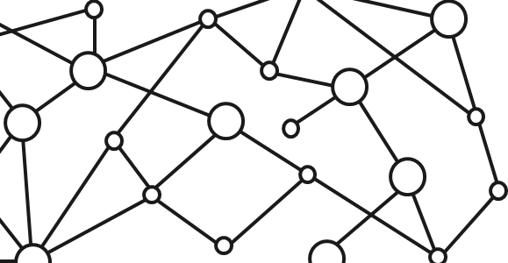
Microsoft 365 Platform
Extend Microsoft 365 experiences
web, device, and service apps
Build your experience
Documents
Pages
Conversations
Timeline
iOS/Android/Windows/Web
1
Microsoft Graph
Notes:
The Microsoft 365 developer vision focuses on the user's experience and their data and as a developer you can bring your application into the user experience with over 1.2 billion users of office worldwide. This is a huge opportunity to provide a window into your application and to enable users to connect into their data and add intelligence to your application.
There are currently over 850 million events created each month and a total of over 400 petabytes of data stored in the service that can add value for your users.
The Microsoft Graph is the gateway to your data in the Microsoft cloud.
The Microsoft cloud includes multiple services and data types that we can take advantage of from Office 365, and it's all considered part of the Microsoft 365 platform.
Developers can integrate the signed-in user's email, calendar, contacts, and tasks into custom apps. We can work with content in SharePoint sites, files in OneDrive, channels and content within Microsoft Teams, and users in Azure Active Directory (Azure AD).
There are many different services that developers can take advantage of in their custom apps. Many of these services have their own APIs developers can interact with.
One of the benefits of Microsoft Graph is that it serves as a proxy endpoint to all of these other services. Microsoft Graph encompass things such as Office 365, Windows 10 enterprise mobility and security (EMS), and it brings all of these different services under one unified endpoint: **graph.microsoft.com**.
The advantage to using Microsoft Graph is that it allows developers to just have a single endpoint, a resource, which means you're only going to need a single access token authenticate the different services. Each service still has its own individual permissions so that everything is still secured in an individual way. A single endpoint makes it easier for developers to build applications.
Microsoft Graph also enables easy navigation of entities and the relationships between entities. While there are many different Microsoft 365 services such as OneDrive for files, or Outlook for contacts and calendars, these different entities are related to each other. These relationships are in Microsoft Graph, which makes it easy to navigate from one entity to another, even if it crosses different underlying endpoints.

Slide 3
Get Change notifications delivered through Azure Event Hubs
Allows Change notifications to be delivered through azure event hubs.
Available for Azure Active Directory (AAD), Exchange, OneDrive, Share Point, Security Graph, Teams Conversations, IC3 platform i.e., Teams meeting, Teams shifts, Teams Presence status, Microsoft outlook TODO, Universal Print
Subscribe to a specific resource e.g., Users.
The notificationUrl field is the event hub connection string exposed through the Azure Key vaults
All notifications are sent to the Event hub specified by the notificationUrl field when creating the subscription
Renew subscriptions for notifications as needed
Create an Azure Event hub listener connected to the event hub you subscribed to.
Notes:
Many custom applications have a need to track and replicate changes between two systems. For example, updates to user information in the master Azure AD directory for an organization, such as office addresses, manager, and contact phone numbers need to be recorded in time reporting systems or other back-office platforms. One way developers can monitor a source system for changes is by polling the system to detect changes.
As you learned in a previous unit, an alternative to the polling pattern, developers can leverage change notifications in Microsoft Graph to be notified when entities change. While this addresses one part of the problem, what happens in the case where a the webhook notificationUrl is unreachable for some reason? In this case, your application may miss changes to entities. In addition, what happens if in cases where the application can not cope with the high number of changes especially in multi tenant scenarios due to lack of resources.
There's another option that developers can leverage for such scenarios in Microsoft Graph. Setting up an Azure event hub and creating a subscription that sends notifications to the event hub solves the problem. You can create an event hub listener related with your subscription.
Microsoft Graph will send all changes to your resource to the Azure Event hub. Your azure event hub listener can then get the change notifications.

Slide 4
Example notification scenarios
Translate an email when it arrives
Start a Flow when a document is X many months old
Create new user accounts in your application when a users joins an organization
Notes:
Let's look at a couple of different example notifications scenarios.
When an email is received, you want to translate it from its native language to another language and make it easier for the consumer to read that email.
When a new user is added to your organization, you want to automatically create an account for that user in your corporate third-party time tracking system and send them an email alerting them that their new account has been set up.
How would you implement these scenarios with change notifications?
You first need to create an app that will host a web API to listen for notifications. This will be the component that will not only trigger the request to create the subscription, but it will also manage subscription renewals and receive and respond to notifications received from Microsoft Graph.

Slide 5
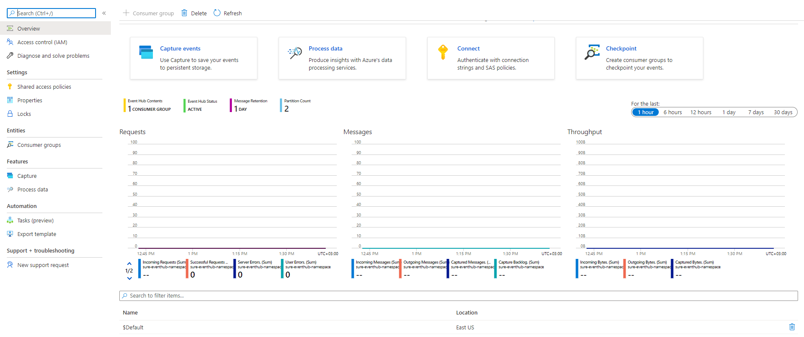
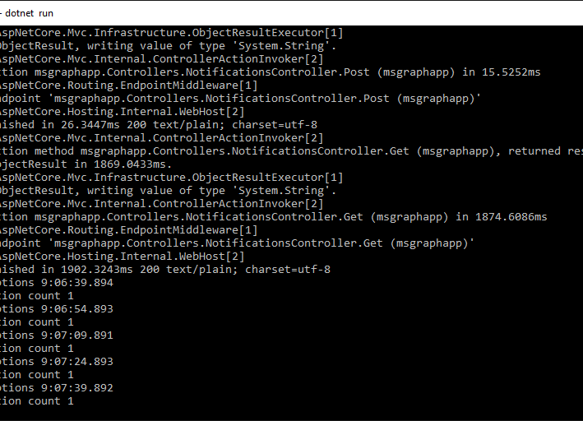
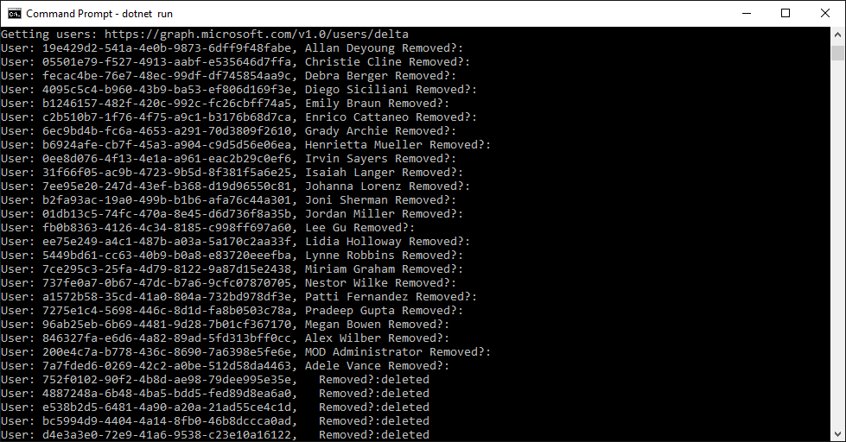
Get notified through azure event hub when user data changes
Create the Azure Event hub
Subscribe for notifications
Receive notifications
Notes:
Creating The Azure event hub
Steps:
Open a browser to the Azure Portal.
Select Create a resource.
Type Event Hubs in the search bar.
Select the Event Hubs suggestion. The Event Hubs creation page will load.
On the Event Hubs creation page, click Create.
Fill in the Event Hubs namespace creation details, and then click Create.
When the Event Hub namespace is provisioned, go to the page for the namespace.
Click Event Hubs and + Event Hub.
Give a name to the new Event Hub, and click Create.
After the Event Hub has been created, click the name of the Event Hub, and then click Shared access policies and + Add to add a new policy.
Give a name to the policy, check Send, and click Create.
After the policy has been created, click the name of the policy to open the details panel, and then copy the Connection string-primary key value. Write it down; you'll need it for the next step.

Slide 6
Demo

Slide 7
Thank you.

